Slide 1
Murach’s Modern JavaScript
Chapter 9
How to work with data validation and exceptions

Slide 2
Objectives
Applied
Use HTML to perform basic data validation.
Customize HTML data validation.
Use try-catch statements to catch exceptions.
Create and throw exceptions.
Knowledge
Identify two limitations of HTML data validation.
Describe the use of the following HTML attributes: autofocus, placeholder, required, title, pattern, novalidate, autocomplete.
Describe how you can use regular expressions to check for a pattern in a string.
Identify three reasons to deliberately throw an exception in your code.

Slide 3
Common types of input controls
email
url
tel
number
range
date
time
Two attributes for working with controls
autofocus
placeholder

Slide 4
A form that uses some of these controls and attributes
<form action="join.php" method="post">
<label for="email_address">Email Address:</label>
<input type="email" id="email_address"
name="email_address" autofocus><br>
<label for="name">Name:</label>
<input type="text" id="name" name="name"><br>
<label for="phone">Phone Number:</label>
<input type="tel" id="phone" name="phone"
placeholder="999-999-9999"><br>
<label>&nbsp;</label>
<input type="submit" id="join_list"
value="Join our List"><br>
</form>

Slide 5
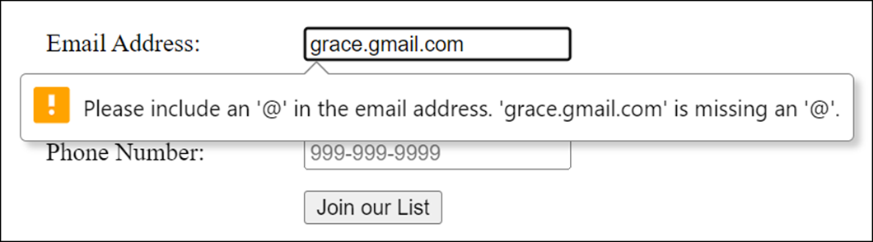
The form in Chrome with an error message for the email address

Slide 6
HTML attributes for data validation
required
title
pattern
novalidate
autocomplete
How HTML data validation is limited
The HTML controls and attributes for data validation may not be implemented the same way by all browsers.
HTML is limited in the types of validation it can do. For example, HTML can’t check whether one control is equal to another.

Slide 7
A form that uses attributes for data validation
<form action="join.php" method="post">
<label for="email_address">Email Address:</label>
<input type="email" id="email_address"
name="email_address" required autofocus
autocomplete="off"><br>
<label for="name">Name:</label>
<input type="text" id="name" name="name" required>
<br>
<label for="phone">Phone Number:</label>
<input type="tel" id="phone" name="phone" required
pattern="\d{3}[\-]\d[3][\-]\d{4}"
title="Must be 999-999-9999"><br>
<label>&nbsp;</label>
<input type="submit" id="join_list"
value="Join our List"><br>
</form>

Slide 8
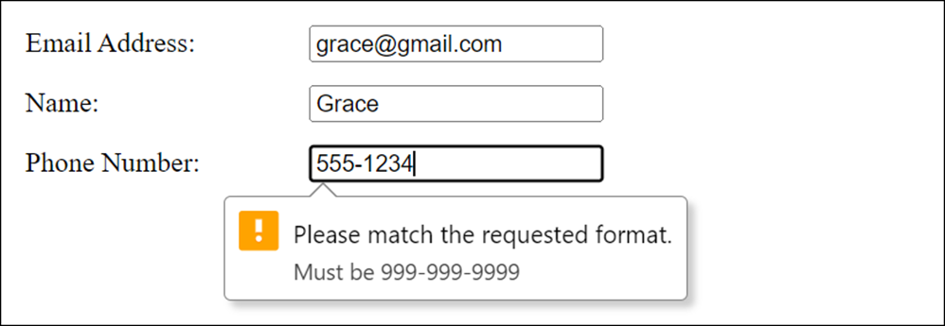
The form in Chrome with an error message for the phone control

Slide 9
How to match special characters
Pattern | Matches
\\ | Backslash
\/ | Forward slash
\t | Tab
\n | New line
\udddd | The Unicode character whose value is the four hexadecimal digits.
\xdd | The Latin-1 character whose value is the two hexadecimal digits. Equivalent to \u00dd.

Slide 10
How to match types of characters (part 1)
Pattern | Matches
. | Any character except a new line (use \. to match a period)
[ ] | Any character in the brackets (use \[ or \] to match a bracket)
[^ ] | Any character not in the brackets
[a-z] | Any character in the range of characters when used inside brackets
\w | Any letter, number, or the underscore
\W | Any character that’s not a letter, number, or the underscore

Slide 11
How to match types of characters (part 2)
Pattern | Matches
\d | Any digit
\D | Any character that’s not a digit
\s | Any whitespace character (space, tab, new line, carriage return, form feed, or vertical tab)
\S | Any character that’s not whitespace

Slide 12
How to group and match subpatterns
Pattern | Matches
(subpattern) | Creates a subpattern (use \( and \) to match a parenthesis)
| | Matches either the left or right subpattern (use \| to match a vertical bar)

Slide 13
How to match a repeating pattern
Pattern | Matches
{n} | Pattern must repeat exactly n times (use \{ and \} to match a brace)
{n,} | Pattern must repeat n or more times
{n,m} | Subpattern must repeat from n to m times
? | Zero or one of the previous subpattern (same as {0,1})
+ | One or more of the previous subpattern (same as {1,})
* | Zero or more of the previous subpattern (same as {0,})

Slide 14
Input controls that validate a phone number and a zip code
<input type="tel" id="phone" name="phone"
pattern="\d{3}[\-]\d[3][\-]\d{4}">
<input type="text" name="zip" id="zip"
pattern="\d{5}([\-]\d{4})?">

Slide 15
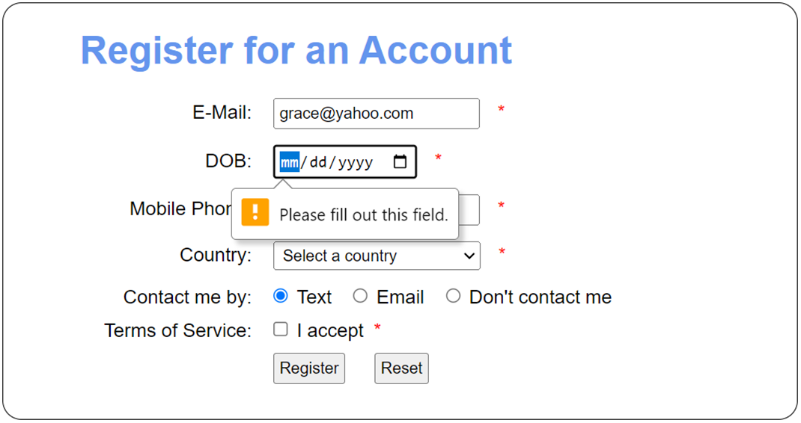
The Register app with an error message

Slide 16
The HTML for the <form> element (part 1)
<form action="confirm.html" method="post">
<label for="email_address">E-Mail:</label>
<input type="email" name="email_address"
id="email_address" placeholder=name@domain.com
autocomplete="off" autofocus required>
<span>*</span><br>
<label for="dob">DOB:</label>
<input type="date" name="dob" id="dob" required>
<span>*</span><br>
<label for="phone">Mobile Phone:</label>
<input type="tel" name="phone" id="phone"
autocomplete="off" required
pattern="\d{3}[\-]\d{3}[\-]\d{4}"
title="Must be nnn-nnn-nnnn">
<span>*</span><br>

Slide 17
The HTML for the <form> element (part 2)
<label for="country">Country:</label>
<select name="country" id="country" required>
<option value="">Select a country</option>
<option>USA</option>
<option>Canada</option>
<option>Mexico</option>
</select>
<span>*</span><br>
<label>Contact me by:</label>
<input type="radio" name="contact" id="text"
value="text" checked>Text
<input type="radio" name="contact" id="email"
value="email">Email
<input type="radio" name="contact" id="none"
value="none">Don't contact me<br>

Slide 18
The HTML for the <form> element (part 3)
<label>Terms of Service:</label>
<input type="checkbox" name="terms" id="terms"
required>I accept
<span>*</span><br>
<label>&nbsp;</label>
<input type="submit" id="register" value="Register">
<input type="reset" id="reset_form" value="Reset">
</form>

Slide 19
A method of an element for data validation
checkValidity()
A property of an element for data validation
validationMessage

Slide 20
The HTML for a form with <span> elements for error messages
<form action="join.php" method="post" novalidate>
<label for="email_address">Email Address:</label>
<input type="email" id="email_address"
name="email_address" required>
<span>*</span><br>
<label for="name">Name:</label>
<input type="text" id="name" name="name" required>
<span>*</span><br>
<label>&nbsp;</label>
<input type="submit" id="join_list"
value="Join our List"><br>
</form>

Slide 21
Validate the email text box on blur
const email = getElement("#email_address");
email.addEventListener("blur", () => {
// clear previous message
email.nextElementSibling.textContent = "*";
// raises invalid event if invalid
email.checkValidity();
});
email.addEventListener("invalid", () => {
email.nextElementSibling.textContent =
email.validationMessage;
email.focus();
});

Slide 22
Validate the form on submit (part 1)
const form = getElement("form");
// attach a handler for the invalid event
// for each control on the form
for (let element of form.elements) {
element.addEventListener("invalid", evt => {
const span =
evt.currentTarget.nextElementSibling;
if (span) span.textContent =
evt.currentTarget.validationMessage;
});
}

Slide 23
Validate the form on submit (part 2)
form.addEventListener("submit", evt => {
// clear previous error messages
for (let element of form.elements) {
const span = element.nextElementSibling;
if (span) span.textContent = "*";
}
if (!form.checkValidity()) {
evt.preventDefault();
}
});

Slide 24
A method of an element that customizes a validation message
setCustomValidity(msg)
The HTML for a form
<form action="join.php" method="post" novalidate>
<!-- email and name input elements -->
<label for="password">Password: </label>
<input type="password" name="password" id="password"
required>
<span>*</span><br>
<label for="confirm">Confirm Password: </label>
<input type="password" name="confirm" id="confirm"
required>
<span>*</span><br>
<label></label>
<input type="submit" id="join_list"
value="Join our List"><br>
</form>

Slide 25
Use custom validation on submit (part 1)
const form = getElement("form");
// attach a handler for the invalid event
// for each control on the form
for (let element of form.elements) {
element.addEventListener("invalid", evt => {
const span =
evt.currentTarget.nextElementSibling;
if (span) span.textContent =
evt.currentTarget.validationMessage;
});
}
form.addEventListener("submit", evt => {
// clear previous error messages
for (let element of form.elements) {
const span = element.nextElementSibling;
if (span) span.textContent = "*";
}

Slide 26
Use custom validation on submit (part 2)
// check if password and confirm password match
const password = getElement("#password");
const confirm = getElement("#confirm");
if (password.value !== confirm.value) {
confirm.setCustomValidity(
"Passwords must match.");
} else {
confirm.setCustomValidity("");
}
if (!form.checkValidity()) {
evt.preventDefault();
}
});

Slide 27
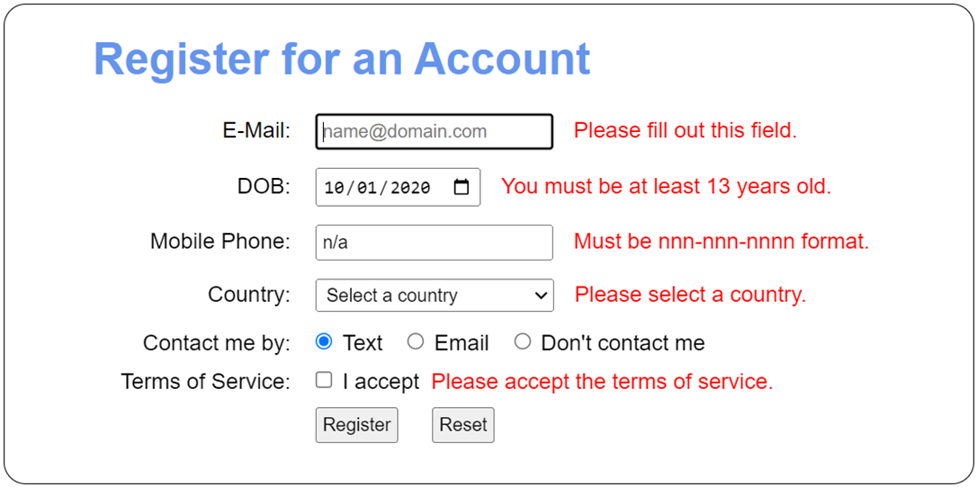
The Register app with error messages

Slide 28
The <form> element of the Register app (part 1)
<form action="confirm.html" method="post">
<label for="email_address">E-Mail:</label>
<!-- same as figure 9-4 -->
<label for="dob">DOB:</label>
<input type="date" name="dob" id="dob" required
title="You must be at least 13 years old." >
<span>*</span><br>
<label for="phone">Mobile Phone:</label>
<input type="tel" name="phone" id="phone"
autocomplete="off" required
placeholder="nnn-nnn-nnnn"
pattern="\d{3}[\-]\d{3}[\-]\d{4}"
title="Must be nnn-nnn-nnnn format." >
<span>*</span><br>

Slide 29
The <form> element of the Register app (part 2)
<label for="country">Country:</label>
<select name="country" id="country" required
title="Please select a country." >
<option value="">Select a country</option>
<option>USA</option>
<option>Canada</option>
<option>Mexico</option></select>
<span>*</span><br>
<label>Contact me by:</label>
<!-- same as figure 9-4 -->
<label>Terms of Service:</label>
<input type="checkbox" name="terms" id="terms" required
title="Please accept the terms of service.">
I accept
<span>*</span><br>
<label>&nbsp;</label>
<!-- same as figure 9-4 -->
</form>

Slide 30
The JavaScript for the Register app (part 1)
const getElement = selector =>
document.querySelector(selector);
const clearMessages = form => {
for (let element of form.elements) {
const span = element.nextElementSibling;
if (span) span.textContent = "*";
}
};
document.addEventListener("DOMContentLoaded", () => {
const form = getElement("form");
// turn off default HTML validation messages
form.noValidate = true;

Slide 31
The JavaScript for the Register app (part 2)
// attach invalid event handler for form controls
for (let element of form.elements) {
element.addEventListener("invalid", evt => {
const elem = evt.currentTarget;
const msg = elem.title ? elem.title :
elem.validationMessage;
const span = elem.nextElementSibling;
if (span) span.textContent = msg;
});
}
form.addEventListener("submit", evt => {
clearMessages(form);
// do custom age validation
const dobElement = getElement("#dob");
const dob = new Date(dobElement.value);

Slide 32
The JavaScript for the Register app (part 3)
const limit = new Date();
limit.setFullYear(limit.getFullYear() - 13);
const msg = (dob > limit) ? dobElement.title : "";
dobElement.setCustomValidity(msg);
// validate form
if (!form.checkValidity()) {
evt.preventDefault();
}
});
getElement("#reset_form").addEventListener(
"click", () => {
clearMessages(form);
getElement("#email_address").focus();
});
});

Slide 33
The syntax for a try-catch statement
try { statements }
catch(error) { statements }
[ finally { statements } ] // optional
Two properties of the Error object
name
message

Slide 34
A function with a try-catch statement
const calcFutureValue = (investment, rate, years) => {
try {
let futureValue = investment;
for (let i = 1; i <= years; i++) {
futureValue += futureValue * rate / 100;
}
return futureValue.toFixed(2);
}
catch(e) {
console.log(e.name + ": " + e.message)
}
};

Slide 35
A catch block that displays a custom message
catch(e) {
console.log(
"The calcFutureValue function has thrown an error.");
}
A catch block with no error parameter
catch {
console.log(
"The calcFutureValue function has thrown an error.");
}

Slide 36
The syntax to create an Error object
new Error(message)
The syntax to throw an exception
throw errorObject;
A function that throws an exception
const calcFutureValue = (investment, rate, years) => {
if (isNaN(investment) || investment <= 0) {
const msg = "calcFutureValue requires " +
"investment greater than 0.";
throw new Error(msg);
}
let futureValue = investment;
for (let i = 1; i <= years; i++ ) {
futureValue += futureValue * rate / 100;
}
return futureValue.toFixed(2);
};

Slide 37
A try-catch statement that catches an exception
try {
const fv = calcFutureValue(investment, rate, years);
getElement("#future_value").value = fv;
} catch(e) {
console.log(e.name + ": " + e.message);
}

Slide 38
Some types of Error objects
Error
RangeError
TypeError
A statement that throws a range error
throw new RangeError(
"Annual rate must be greater than zero.");
Three reasons for using throw statements
To alert code that calls a function that something is wrong
To test the operation of a try-catch statement
To perform some processing after catching an error and then throw the error again

Slide 39
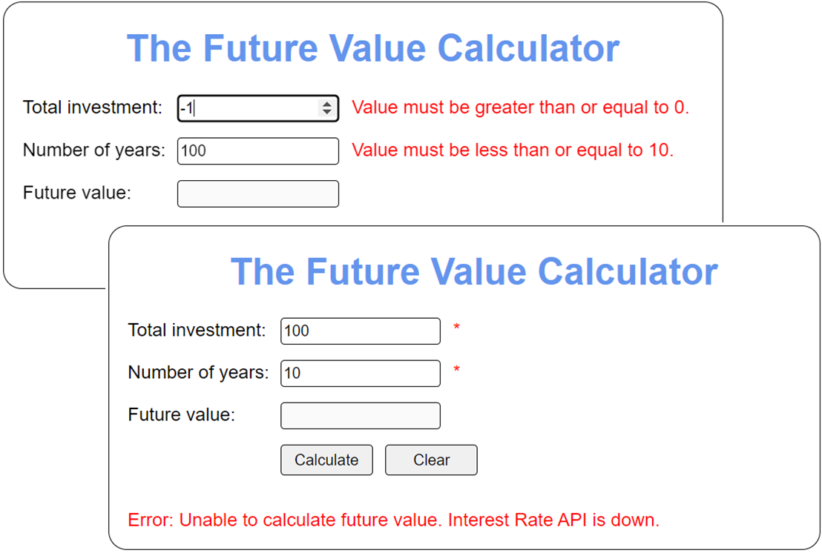
The Future Value app with error messages

Slide 40
The HTML for the <body> element (part 1)
<body>
<form action="#" method="post">
<h1>The Future Value Calculator</h1>
<label for="investment">Total investment:</label>
<input type="number" id="investment"
min="0" max="1000" step="100" required
autofocus>
<span>*</span><br>
<label for="years">Number of years:</label>
<input type="number" id="years" min="0" max="10"
step="1" required>
<span>*</span><br>
<label>Future value:</label>
<input type="text" id="future_value" disabled>
<br>

Slide 41
The HTML for the <body> element (part 2)
<label></label>
<input type="submit" id="calculate"
value="Calculate">
<input type="reset" id="clear" value="Clear">
<p id="message"></p>
</form>
<script src="calc_future_value.js"></script>
<script src="future_value.js"></script>
</body>

Slide 42
The calc_future_value.js file (part 1)
// function that simulates an external service
// that is sometimes down
function getCurrentInterestRate() {
const random = Math.ceil(Math.random() * 10);
if (random === 1) {
throw new Error("Interest Rate server is down.");
} else {
return 3.9;
}
};
function calcFutureValue(investment, years) {
// convert to numeric values
investment = parseFloat(investment);
years = parseInt(years);

Slide 43
The calc_future_value.js file (part 2)
// throw error if investment or years aren't
// numbers greater than zero
if (isNaN(investment) || investment <= 0) {
throw new Error("Investment must be a number " +
"greater than zero.");
}
if (isNaN(years) || years <= 0) {
throw new Error(
"Years must be a number greater than zero.");
}
// get interest rate - throw error if service returns
// an error
let rate = 0;
try {
rate = getCurrentInterestRate();
} catch(e) {
throw new Error(
"Unable to calculate future value. " +
e.message);
}

Slide 44
The calc_future_value.js file (part 3)
// if no errors, calculate and return future value
let futureValue = investment;
for (let i = 1; i <= years; i++) {
futureValue += futureValue * rate / 100;
}
return Number(futureValue.toFixed(2));
};

Slide 45
The future_value.js file (part 1)
const getElement = selector =>
document.querySelector(selector);
const clearMessages = () => {
getElement("#investment").nextElementSibling
.textContent = "*";
getElement("#years").nextElementSibling
.textContent = "*";
getElement("#message").textContent = "";
}
document.addEventListener("DOMContentLoaded", () => {
const form = getElement("form");
// turn off default HTML validation messages
form.noValidate = true;

Slide 46
The future_value.js file (part 2)
// attach invalid event handler for form controls
for (let element of form.elements) {
element.addEventListener("invalid", evt => {
const elem = evt.currentTarget;
const span = elem.nextElementSibling;
if (span) span.textContent =
elem.validationMessage;
});
}
form.addEventListener("submit", evt => {
clearMessages();
evt.preventDefault(); // prevent form submission
// get future value text box and clear any
// previous value
const fv = getElement("#future_value");
fv.value = "";

Slide 47
The future_value.js file (part 3)
// if form is valid, display future value
// or error message
if (form.checkValidity()) {
try {
const investment =
getElement("#investment").value;
const years = getElement("#years").value;
fv.value = calcFutureValue(investment,
years);
} catch(e) {
const msg = `${e.name}: ${e.message}`;
getElement("#message").textContent = msg;
}
}
});
getElement("#clear").addEventListener("click", () => {
clearMessages();
getElement("#investment").focus();
});
});

